Slide 1


Slide 2

Functional & Non- Functional Requirements
Amanda Stefanese
Ahmed Mahmoud
Joe Skinner

Slide 3
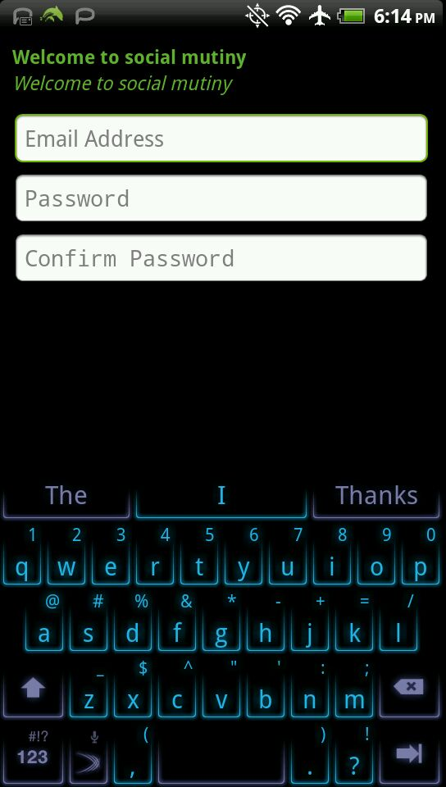
Functional Requirements
Registration
Sign In
Profile
Email
Password
Confirm Password
Email
Password
Remember Me
User Information
Last Name
First Name
Age
Profile Image
Info
Posts
Status Updates
Uploaded Photos
Whiteboard Posts
Privacy Settings
Search-ability
Blocked Users
Audience
Account Settings
Private Messaging
First & Last Name
First Name
Last Name
Search
Block
Stay Logged on Setting
Filter (Friends Only Y/N)
Chat Settings
Password Change
Change of Email
User Name
Log Out

Slide 4
Non- Functional Requirements
Database
Android Phone
Web Browser
Windows Platform
Cookies
Web Cache
Server
Internet Connections
Desktop Client

Slide 5
Case Diagrams
Amanda Stefanese
Ahmed Mahmoud
Joe Skinner

Slide 6
Registration
Sign In
User Information
Profile
Posts
User
Settings
Account Settings
Search
Privacy Settings
Private Messaging
Chat
Settings
Log Out

Slide 7
User Case Description
Registration
User can register by using their email, choosing a password, and confirming their password
Sign In
Users already enrolled can sign in by using their email and password. They also have a remember me function which will sign the user in automatically without inputting their information.
Profile
Profile is made up of User Information and Posts.
User Information
User information is a collection of semi personal information such as the user’s First & Last names, age, profile image (.jpg and .gif)
Posts
A user can post on their profile by updating status, uploading photos, and posting white board posts.
Settings
Users can adjust their settings
Account Setting
In account settings users can change their user name, email address, and password.
Privacy Settings
In privacy settings uses can edit their search-ability (who can search them in the search bar), Change their audience, (who can view their page), and block other users from viewing or searching their profile.
Chat Settings
In chat settings users can edit filters to limit the people can chat with them. They can choose a stay logged on setting and they can also block other users from chatting with them.
Search
Users can search for other users in the search bar by first name, last name, or first and last name together.
Private Messaging
Users can private message other users. Unlike chat private messaging is not in real time.
Log Out
With this option users can log out of their account, which closes their profile and chat, and they can no longer access their settings.

Slide 8
Maintenance
Bug Fixes
Browser
Staff
Updates
Layout
Sounds
Graphics
Staff
Maintenance
Bug Fixes
Android
Staff
Updates

Slide 9
Staff Case Description
Browser Staff
Android Staff
Graphics Staff
Maintenance
Maintain the site to make sure everything is working correctly/ functioning
Bug Fixes
Any errors/ bugs in the code or any glitches will be fixed by this staffer.
Updates
Updates to enhance the site or add new features
Maintenance
Maintain the application to make sure everything is working correctly/ functioning
Bug Fixes
Any errors/ bugs in the code or any glitches will be fixed by this staffer.
Updates
Updates to enhance the application or add new features
Layout
All design, layouts, structure and logos will be created by Graphics Staff.
Sounds
Any notification sounds or pop-ups will be created by this staff.

Slide 10
Search
Browse Database
Browser
Search
Connects to API
Android App

Slide 11
Browser
Case Description
Android App
Case Description
Search
Connects to the database and searches for the given information and the returns the results.
Browse Database
Collects data from the database and transfers it to the browser to be viewed by the user
Search
Connects to the database and searches for the given information and the returns the results.
Connects to API
Android Application connects to the API which then connects to the database to receive all user information.

Slide 12
Sequential Diagram
Amanda Stefanese
Ahmed Mahmoud
Joe Skinner

Slide 13
Browser Sequential Diagram
User
Web Server
Database
Web Server
User

Slide 14
Android Sequential Diagram
User
Web Server
Database
Web Server
User
API
API

Slide 15
GUI for Android Application
Amanda Stefanese
Ahmed Mahmoud
Joe Skinner

Slide 16
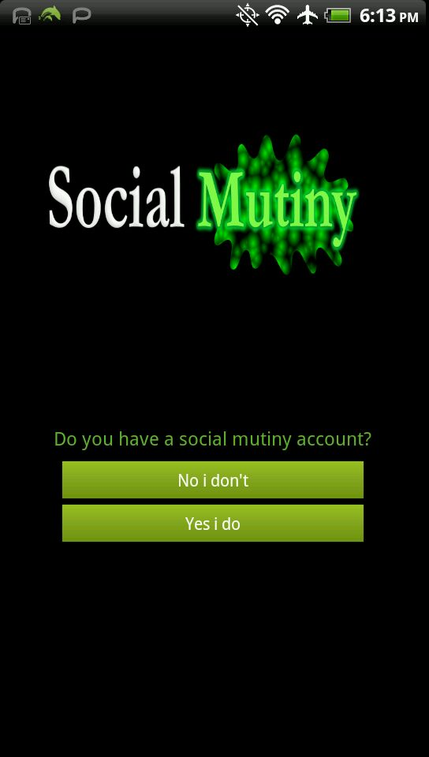

Slide 17
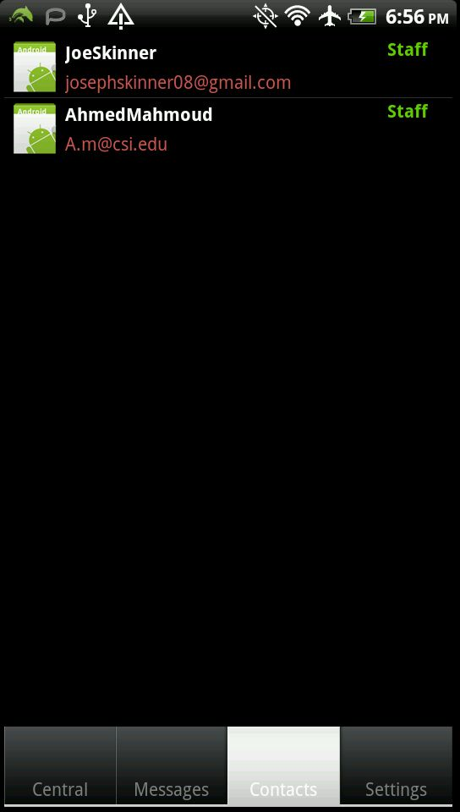
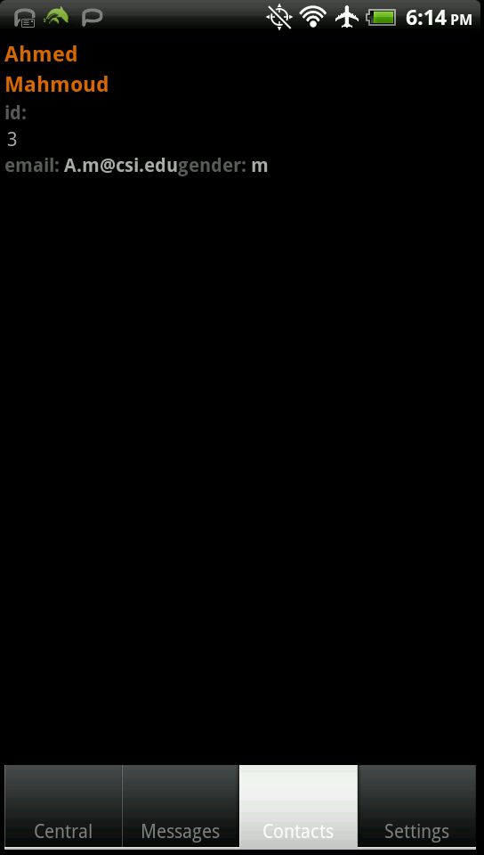

Slide 18
GUI for Browser
Amanda Stefanese
Ahmed Mahmoud
Joe Skinner

Slide 19
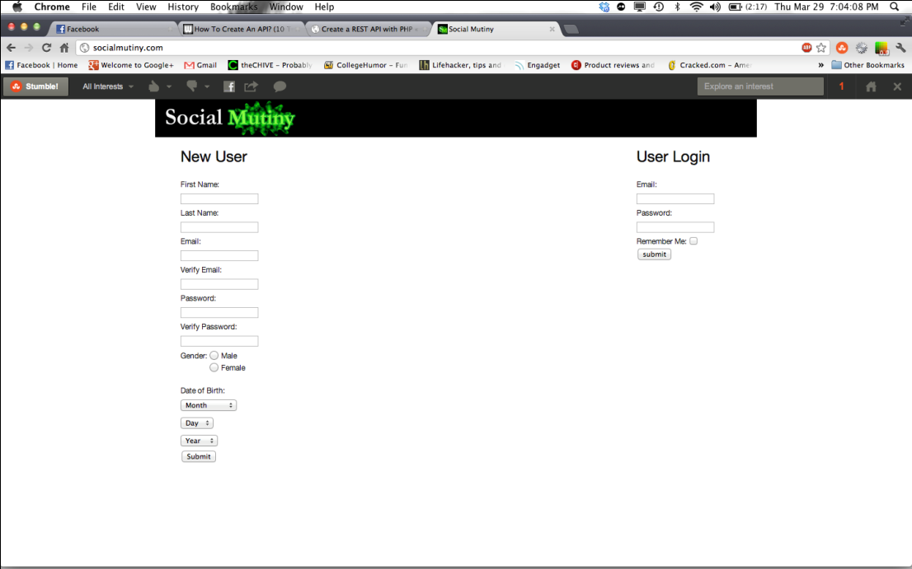
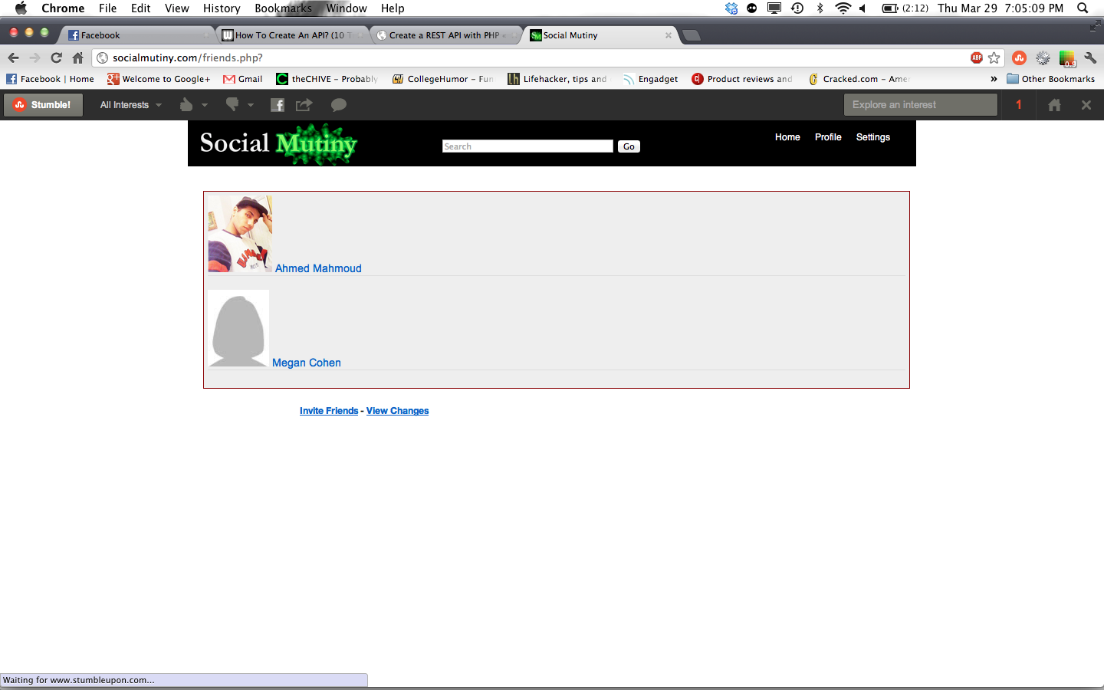

Slide 20
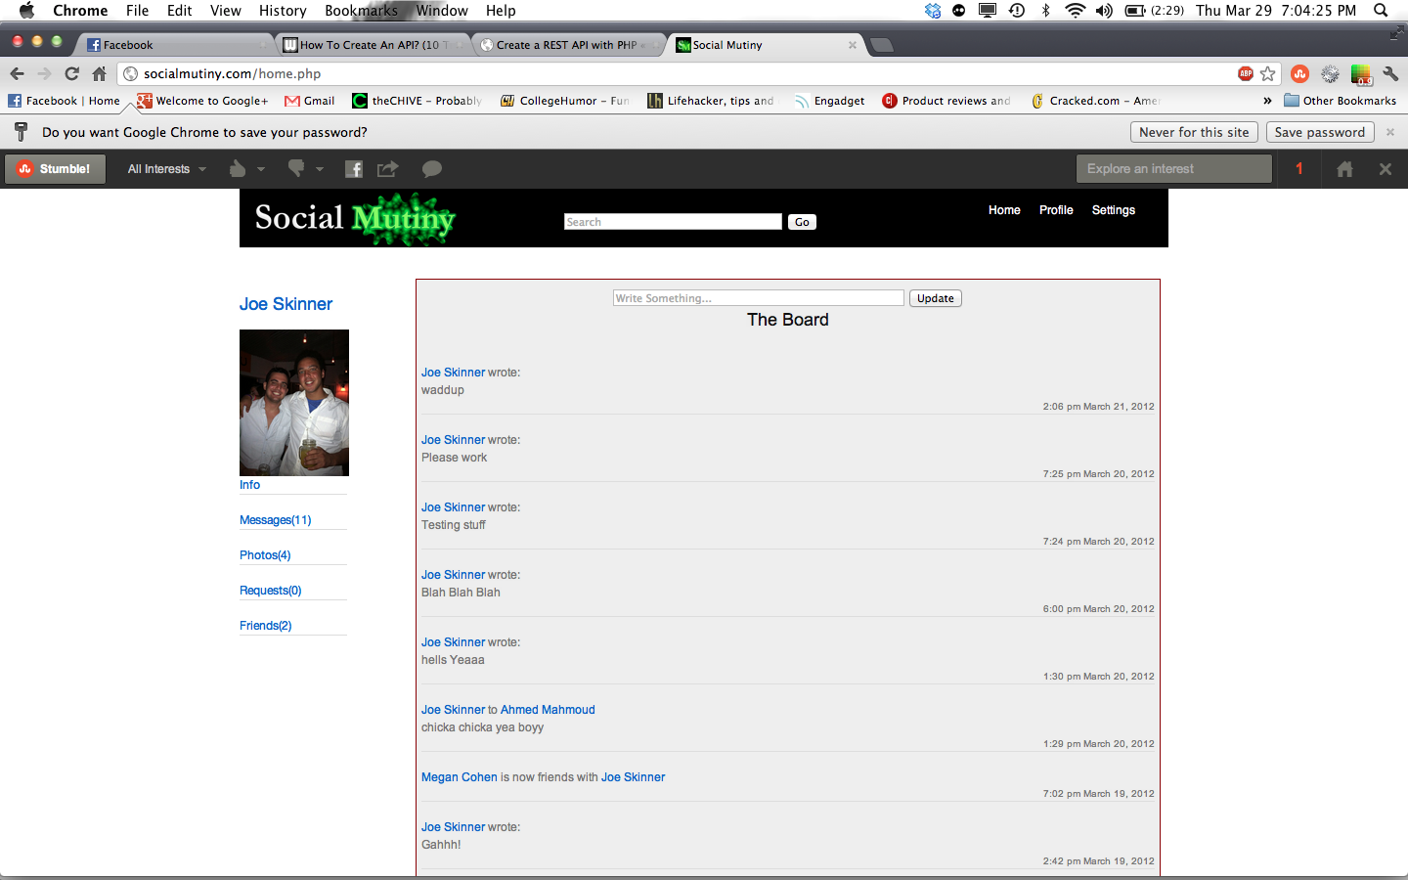
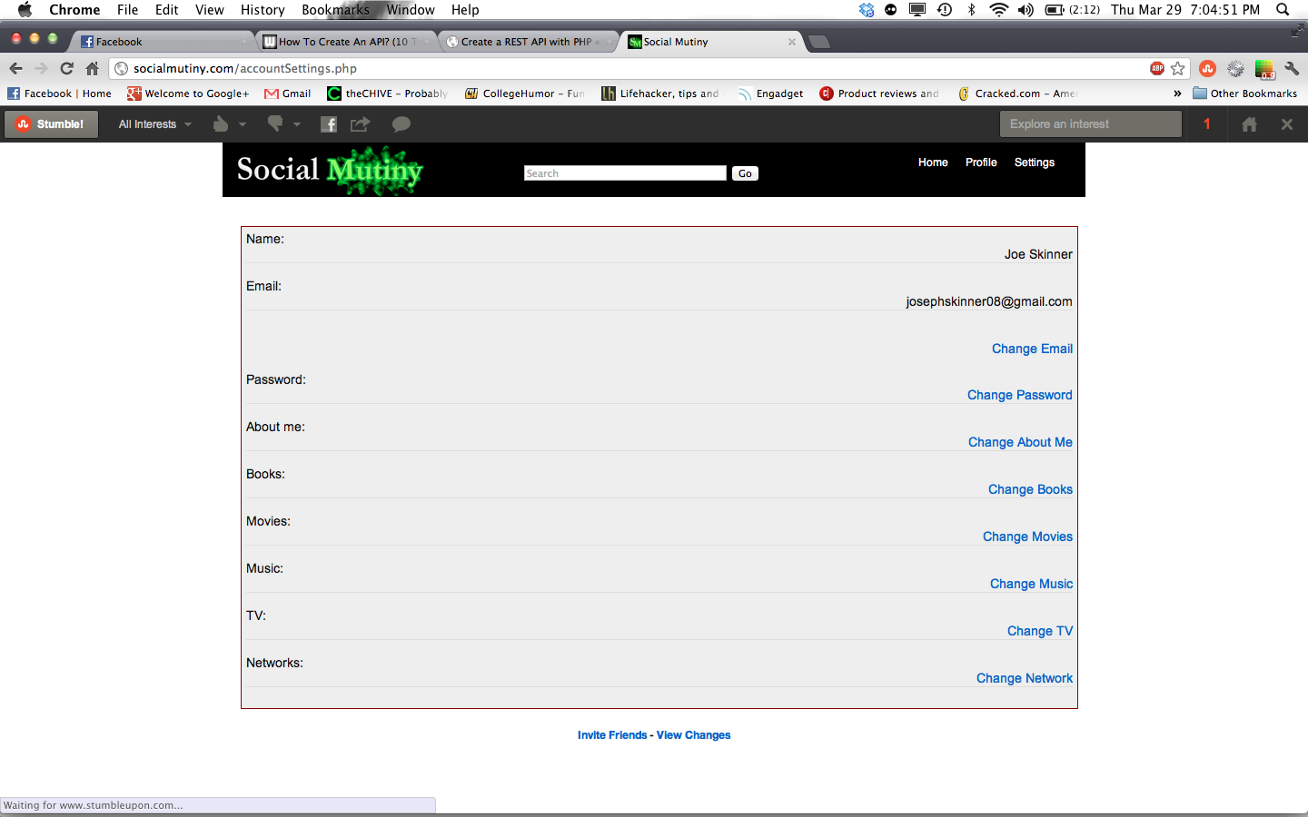

Slide 21
